Slide 1
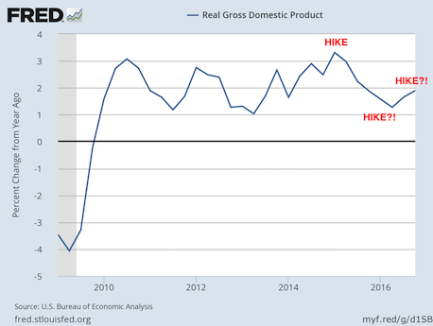
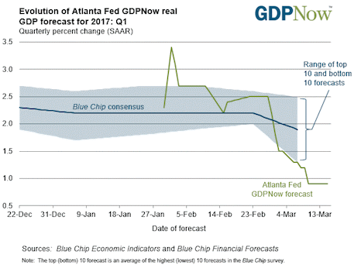
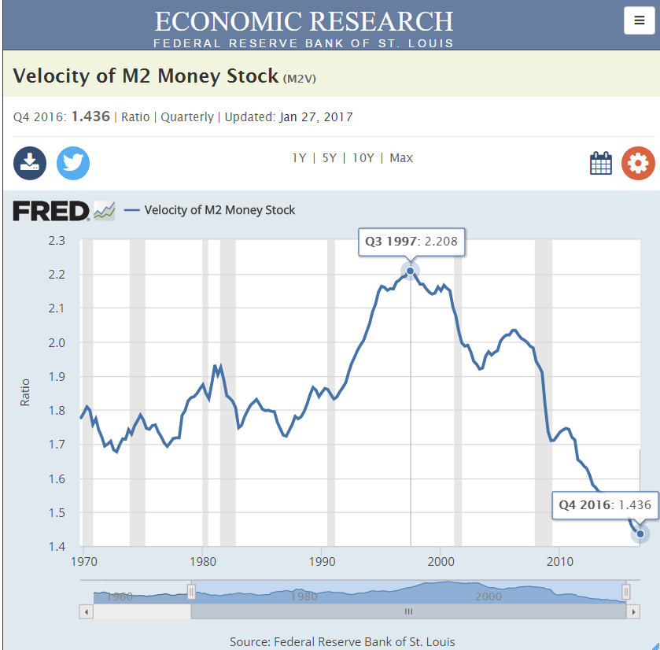
ITM Trading Educational Series Presents…
“Flash in Five”
Enabling Educated Choices
Fed Funds Rate Raised ¼% 3-15-17
In the Fed’s Words; the Real Reasons Rates Were Raised
"We have seen the economy progress over the last several months in exactly the way we anticipated," "We have some confidence in the path the economy is on.“
Fed Chair Janet Yellen, in a press conference following the end of a two-day policy meeting
GDP = Economy
Below 2%
Annual Percentage Change
Anticipated GDP Direction
Spending
Below 1%
Created by Lynette Zang
Chief Market Analyst, ITM Trading, Inc.
The information in this Webinar has been carefully compiled from sources believed to be reliable, but the accuracy of the information is not guaranteed. The author, Lynette Zang was a licensed investment advisor but no longer maintains those licenses. This broadcast is not intended as investment advice. The opinions expressed are those of the author. Neither Lynette Zang nor ITM Trading can guarantee that any products offered by ITM will rise in value. You should be aware that prices will fluctuate and may go down as well as up. Strategies mentioned in this webinar may not be suitable for you. Past performance is never an indication of future profits. Before purchasing coins you should read ITM’s Risk Information and Purchase Policy documents. Coins should be considered a long term hold for a portion of your investment portfolio. If you have any tax or other questions please consult a financial professional.
March 21, 2017
888-696-4653
Safeguarding Americans From the Fiat Money Disease
Notes:
“The Crisis, The Bail-In and The SDR”
Welcome to A Peek Beneath the Skin of the Markets, which is all about educated choices.
Unseen by most, at midnight on December 31st , global power shifted from the US to the IMF. I believe this shift seals the fate of the US dollar as “The” World’s reserve currency and will have great impact on every American and every US dollar denominated instrument. Make no mistake, the countdown has begun.
In this webinar, we’ll discuss the looming “required” market crisis that will most likely result in a bank bail-in AND taxpayer bail-out, but that won’t be enough. Enter the IMF Bankers, with the synthetic SDR made out of thin air. Today we’ll take a quick look at how the upcoming events are likely to impact you and your family.
It’s been said that a very big crisis would enable the final shift out of the dollar standard to the SDR standard. The pattern that repeats during these shifts are wars, high inflation and fiat market crashes.
The US just moved troops near the Russian boarder. Interest rates have been spiking in anticipate of Trumpflation.
And the stock, bond and real estate markets have been inflated to severely high valuations with no buyers should there be a run in any market. But most people glance at the stock market for assurance, so that is the biggest tool used to hold public confidence.

Slide 2
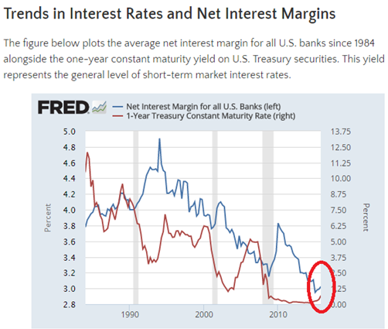
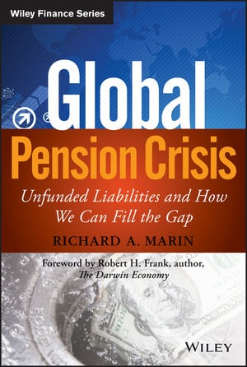
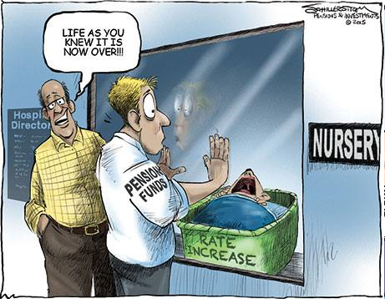
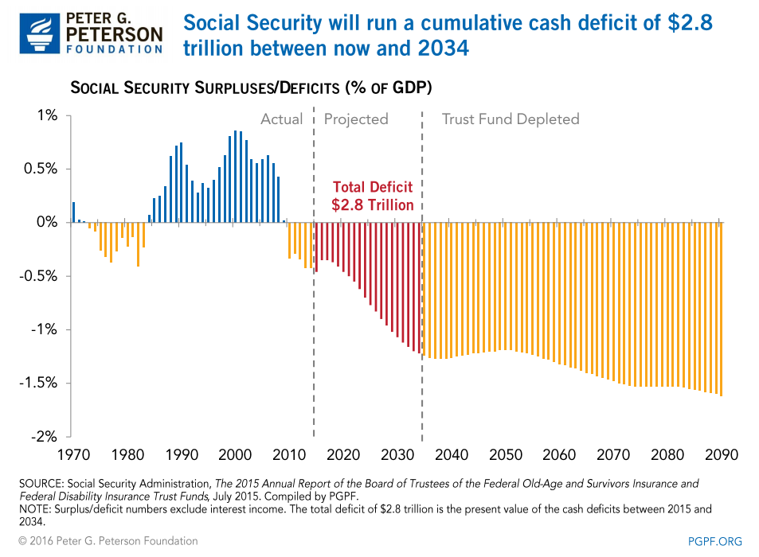
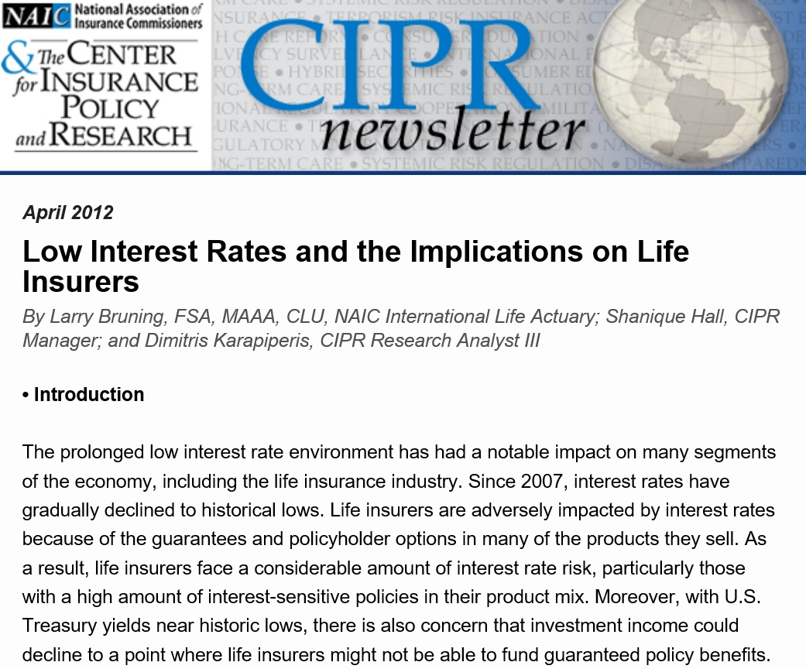
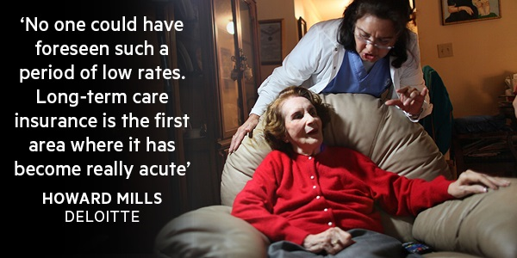
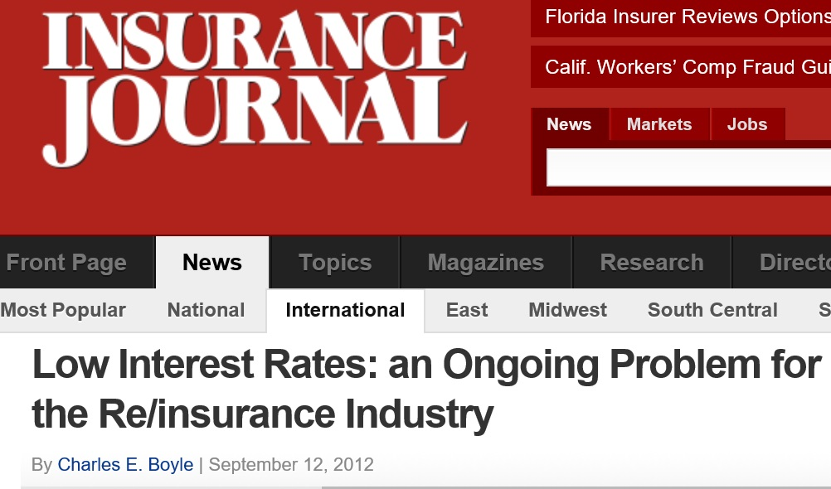

Slide 3
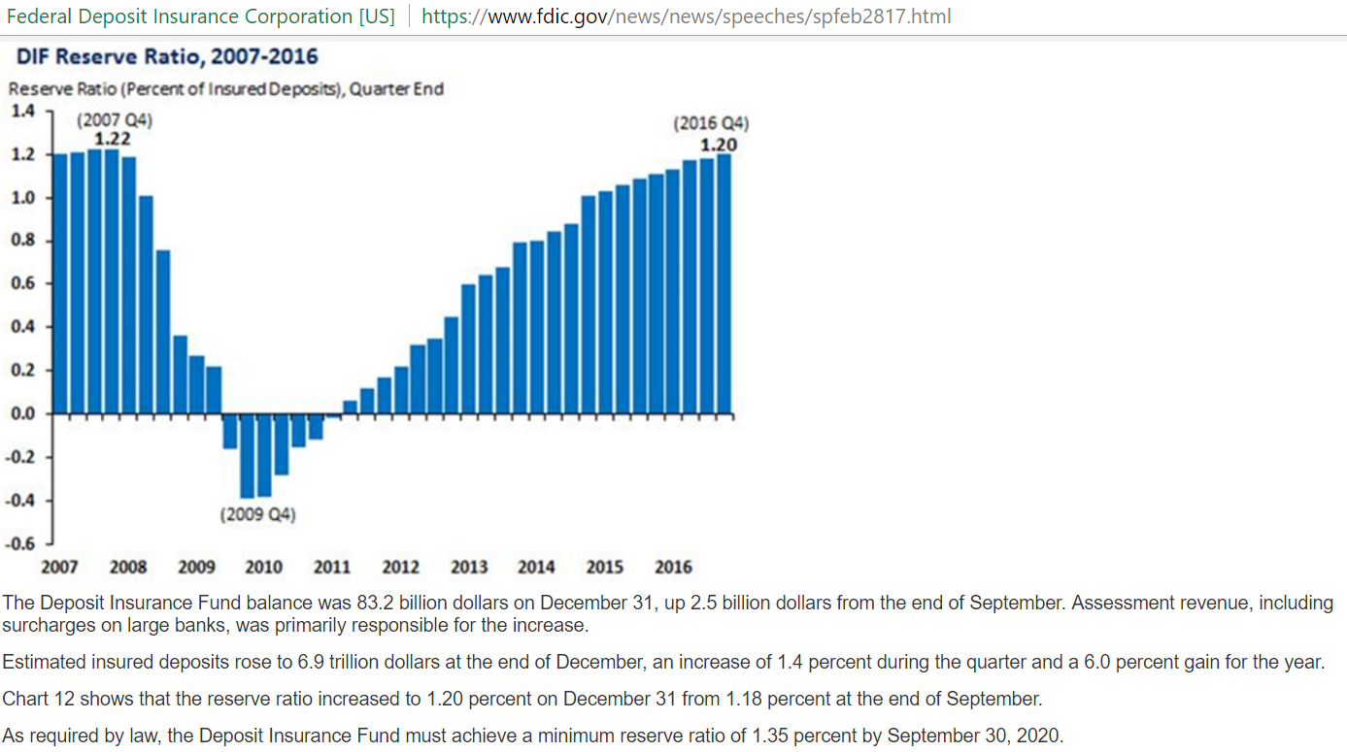
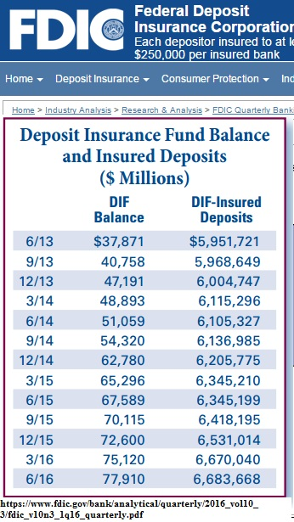
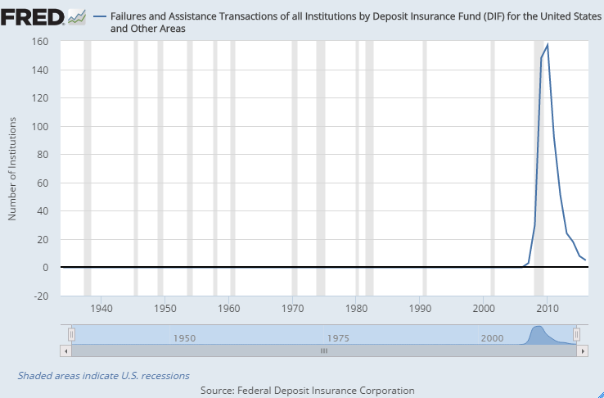
FDIC Insurance Fund supports public confidence in banks
# Failed Banks
Using FDIC Support
If Reserves no longer go into the calculation for DIF premiums, there will be even less in the insurance fund to pay out insured deposits during the next crisis.
Reflation Trade
FDIC Insurance Fund was on the brink of obvious failure
There is 1 penny for Every Insured $1.00
Bil
Tril
Bail-in Anyone?

Slide 4
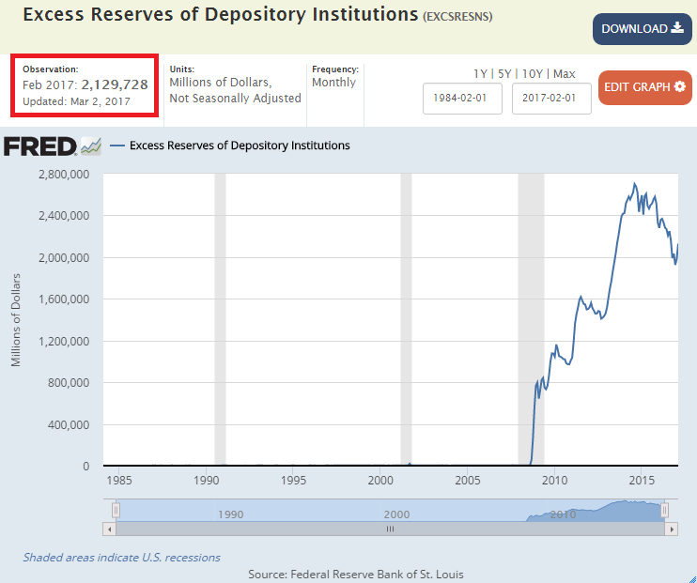
Excess Reserves of Banks
Trillion
?
Can You See the Pattern Shift?
Insurance Fund & Bank Reserves
Determine DIF Fund Premium
.25% Oct. 2008
.50% Dec. 2015
9/11
.75% March 2017
2008

Slide 5
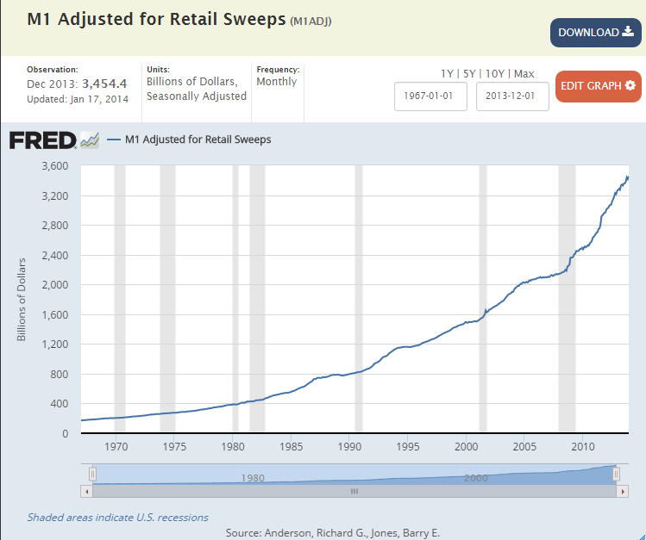
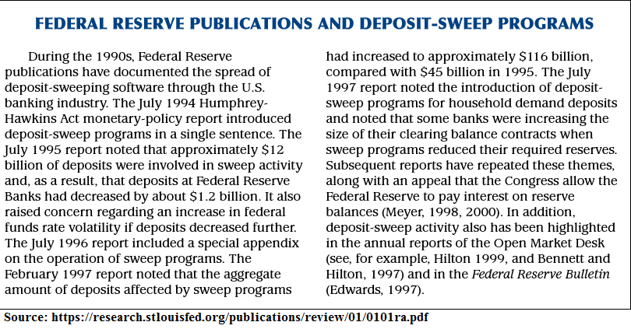
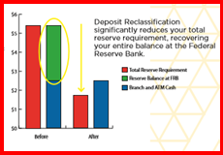
Allows the bank to “Sweep” deposits
into “Sub Accounts” and
avoid reserve requirements
1997 Sweep Programs for Households Begins
Reduced Reserves on $3.5Trillion Deposits in Sweep Program
Notes:
In the 90’s Federal Reserve Reg Dbank
Sweep funds and is referred to at Deposit Reclassification and is the foundation of the “Bail in” laws we’ll talk about in a few mins.
Banks can use for their benefit
Sample notice tells you will not notice any change, but it’s for their benefit.
http://www.marketskeptics.com/2009/03/deposit-reclassification-used-to.html

Slide 6
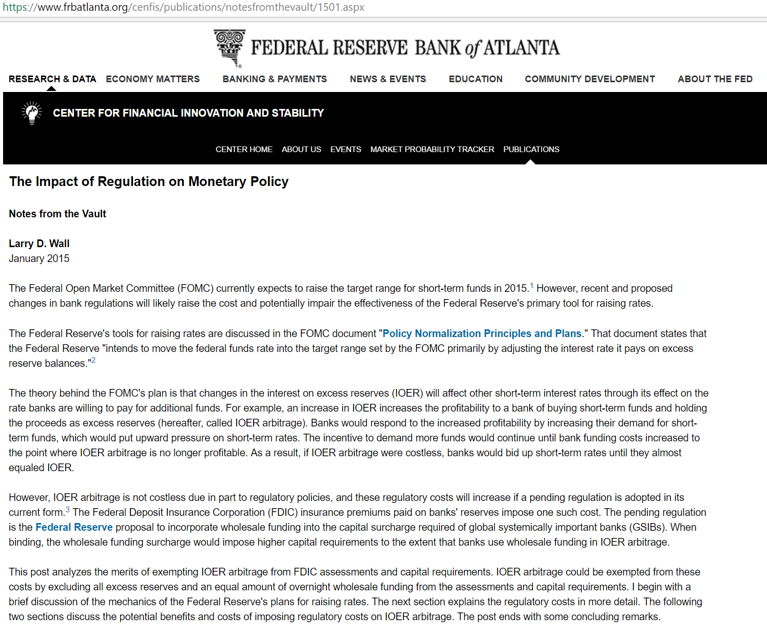
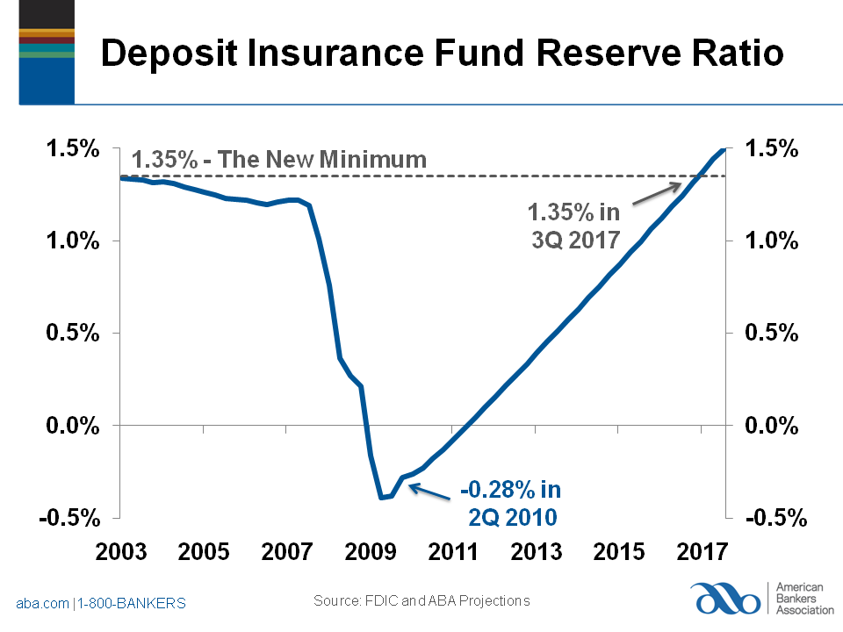
Regulatory Increases Required
Rules Are Easy and Invisible to Change
Additional Costs Shift to Taxpayer

Slide 7
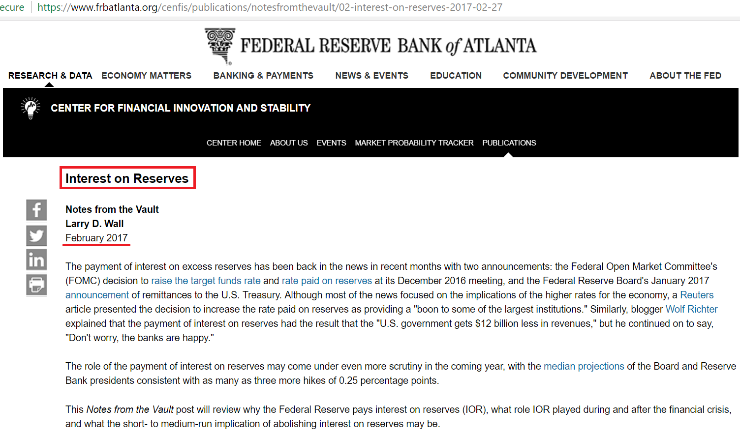
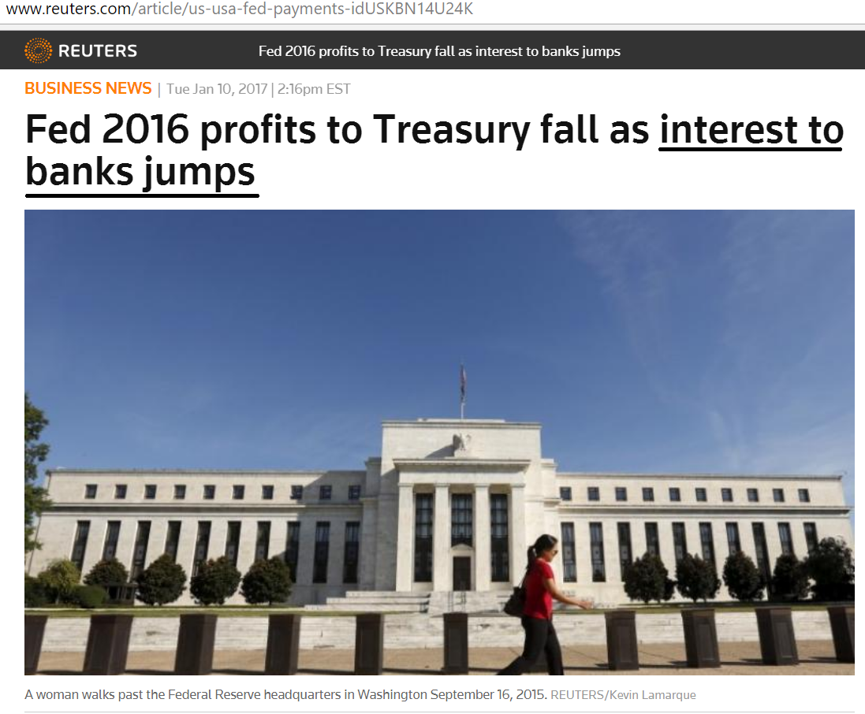
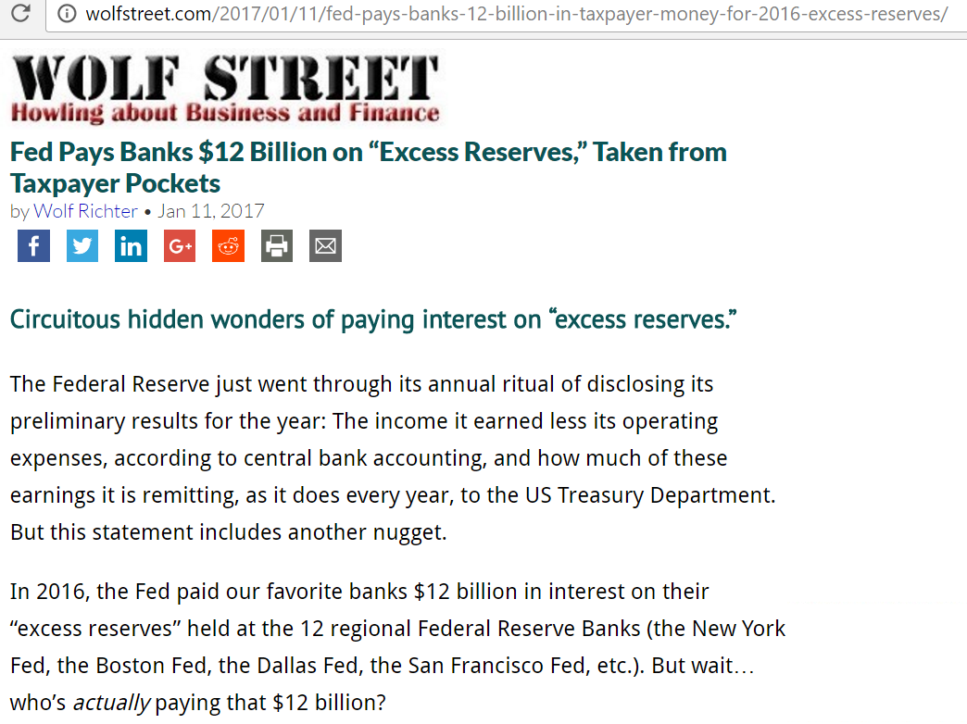
Removing bank reserves from DIF premiuns, supports costless income for banks, (taxpayers bear the cost)
This Information Now Being Discussed on Main Street

Slide 8
"We have seen the economy progress over the last several months in exactly the way we anticipated," "We have some confidence in the path the economy is on.“
Fed Chair Janet Yellen, in a press conference following the end of a two-day policy meeting

